Slide 1
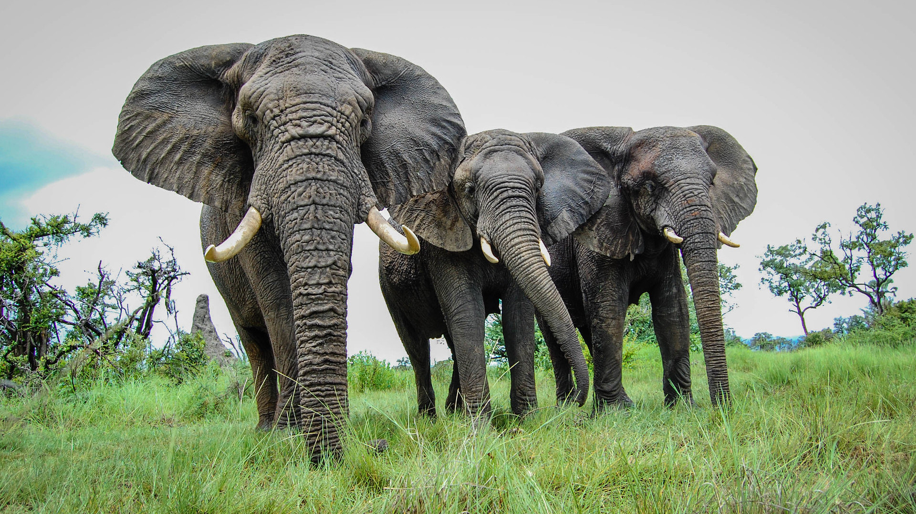
Project 15 Counting Elephants by Base Frequency Spectrogram Analysis in Real Time
University of Oxford
Artificial Intelligence: Cloud and Edge Implementations
Cohort 2020-2021, Group 4
In cooperation with Cornell University and Microsoft

Slide 2
Group 4 Team
Our team is composed of:
Abhishekh Baskaran - https://www.linkedin.com/in/abhishekh-jay-baskaran-566286bb/
Bas Geerdink - https://www.linkedin.com/in/geerdink/
Chandan Konuri - https://www.linkedin.com/in/konuri/
Henrietta Ridley - https://www.linkedin.com/in/henriettaridley/
Jay Padmanabhan - https://www.linkedin.com/in/jay-padmanabhan-95274b/
Paulo Henrique De Campos Filho - https://www.linkedin.com/in/paulohcampos/
Vishweshwar Manthani - https://www.linkedin.com/in/vishweshwar/

Slide 3
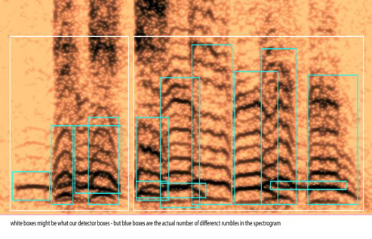
Goal
The goal of the project was to count the number of elephants in a sound file
To do so, we detected whether rumbles are belonging to the same elephant or not

Slide 4
Literature
Poole, Joyce H. (1999). Signals and assessment in African elephants: evidence from playback experiments. Animal Behaviour, 58(1), 185-193
Jarne, Cecilia (2019). A method for estimation of fundamental frequency for tonal sounds inspired on bird song studies. MethodX, 6, 124-131
Stoeger, Angela S. et al (2012). Visualizing Sound Emission of Elephant Vocalizations: Evidence for Two Rumble Production Types.
O'Connell-Rodwell, C.E. et al (2000). Seismic properties of Asian elephant (Elephas maximus) vocalizations and locomotion. Journal of the Acoustic Society of America, 108(6), 3066-3072
Heffner, R. S., & Heffner, H. E. (1982). Hearing in the elephant (Elephas maximus): Absolute sensitivity, frequency discrimination, and sound localization. Journal of Comparative and Physiological Psychology, 96(6), 926–944
Elephant Listening Project, Cornell University: https://elephantlisteningproject.org/
Project 15, Microsoft: https://microsoft.github.io/project15/

Slide 5
Introduction
Sound files can be analysed by transforming them into a 2D image: a spectrogram of time (seconds) vs frequency (Hertz). The third dimension is sound intensity (decibel), which can be shown as a colour or grayscale.
Elephants produce rumbles to communicate with a typical frequency of 10 – 50 Hz and lasting 2 - 6 seconds
One elephant rumble will have many harmonics, which are sound waves of increasing frequency.
An elephant can be identified by its base frequency. If there are two slightly overlapping or separated rumbles with a different base frequency, they probably belong to separate animals.
Notes:
Bas

Slide 6
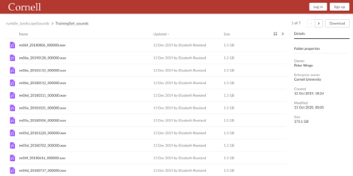
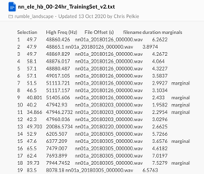
Data
We received a set of sounds files (.wav) and metadata that pointed us to the segments where elephants were likely to produce rumbles.
Challenges:
Big data set
Joining the files might be a challenge
Labels / annotations don't mention the number of elephants

Slide 7
Data Pipeline
Segmenting data: based the metadata files, we create segments of a few seconds that contain the interesting information
Spectrograms: each data segment is transformed into a 2D image of time vs frequency (10-50 Hz), using FFT transformation algorithm, lowpass/highpass filters, and frequency filters
Noise reduction: each spectrogram is reduced of noise and transformed into a simple monochrome (black and white) image
Contours detection: each monochrome image is evaluated with a contour detection algorithm, to distinguish the separate 'objects' which in our case are the elephant rumbles
Boxing: for each contour (potential elephant rumble) we calculate the size (height and width) by drawing a box around the contour
Counting: we compare the boxes that identify the rumbles to each other in each spectrogram. Based on a few business rules, we count the number of unique elephant rumbles in each image

Slide 8
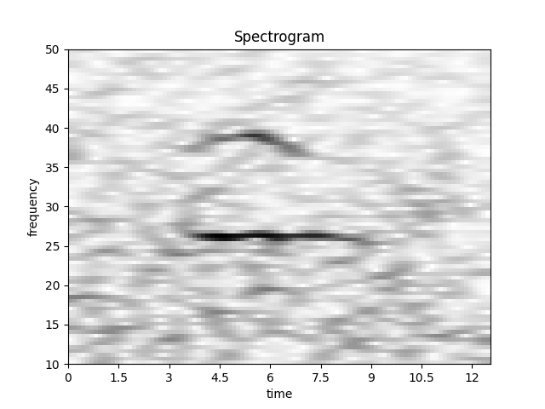
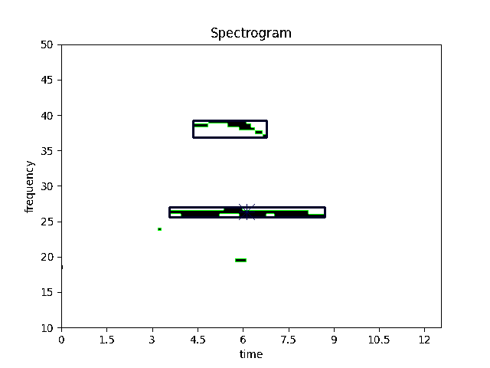
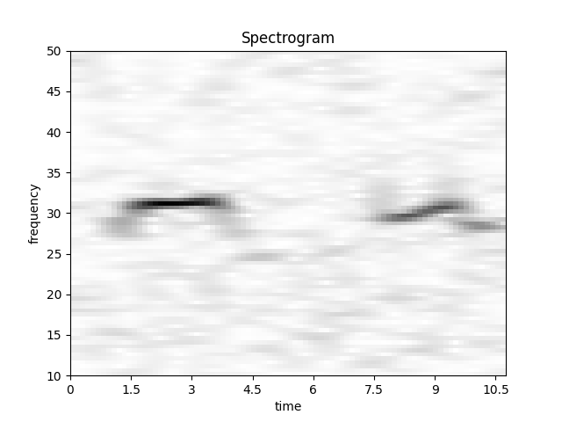
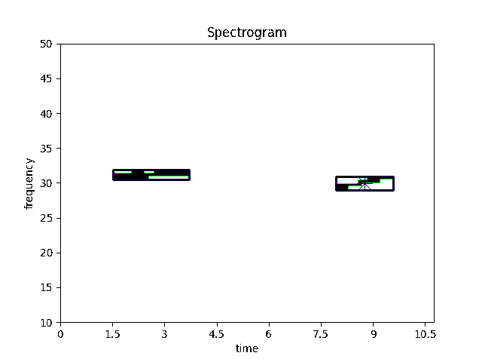
Samples
Steps 1, 2
Steps 3, 4, 5
Step 6
"1 elephant"
In this example, we see two harmonics of one elephant rumble
"1 elephant"
In this example, we see two elephant rumbles with the same base frequencies, a few seconds apart; they probably belong to the same animal

Slide 9
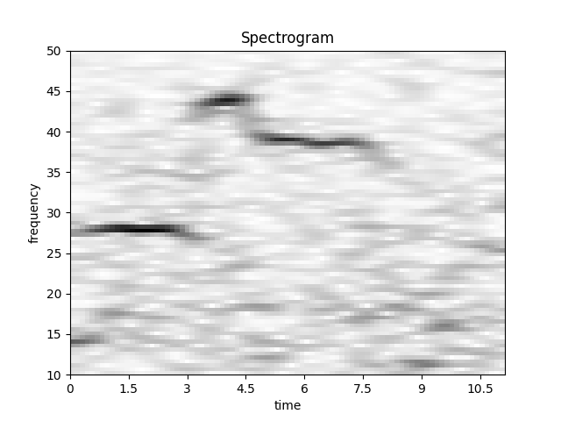
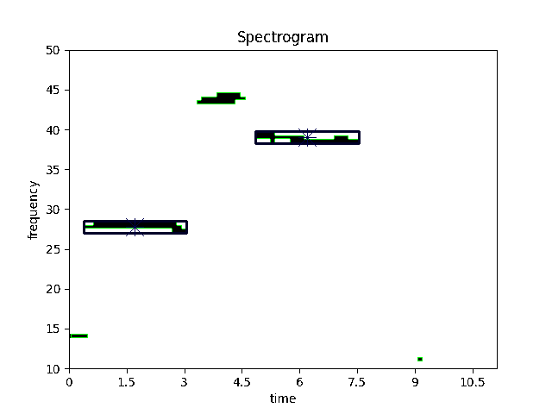
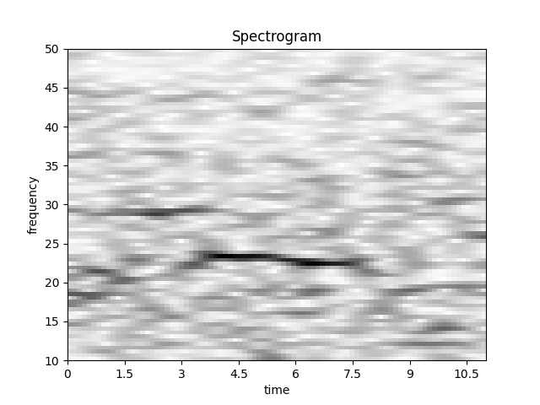
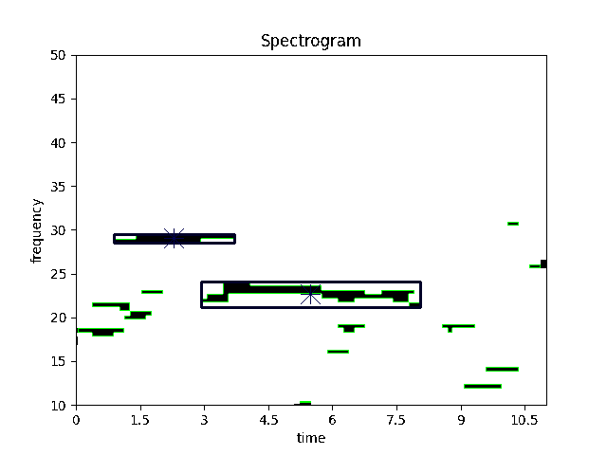
Samples
Steps 1, 2
Steps 3, 4, 5
Step 6
"2 elephants"
In this example, we see two elephant rumbles with different base frequencies; they probably belong to separate animals
"2 elephants"
In this example, we see two elephant rumbles with different base frequencies; they probably belong to separate animals

Slide 10
Source Code
The source code is made available at: https://github.com/AI-Cloud-and-Edge-Implementations/Project15-G4
All code is written in Python and runs on premise or in the cloud (Azure)
We used the following frameworks to process and analyze the data:
boto3 for connecting to Amazon AWS
Numpy, Pandas, SciPy and MatPlotLib for statistical analysis and visualization
Librosa for FFT
noisereduce for noice reduction
SoundFile
OpenCV for contour detection

Slide 11
Results
We analysed 3935 elephant sounds:
112 spectrograms were identified as containing 0 elephants
3277 spectrograms were identified as containing 1 elephant
505 spectrograms were identified as containing 2 elephants
40 spectrograms were identified as containing 3 elephants

Slide 12
Results of the Boxing algorithm
The boxing algorithm was evaluated by Liz Rowland of Cornell University
The reported accuracy of the model is:
97.29 % for the Training dataset (3180 cases)
99.29 % for the Testing dataset (758 cases)
This proves that the model is useful for counting elephants
In combination with other models (elephant detection), many interesting use case can be built with this model, for example visualizing elephant movements and detecting poaching

Slide 13
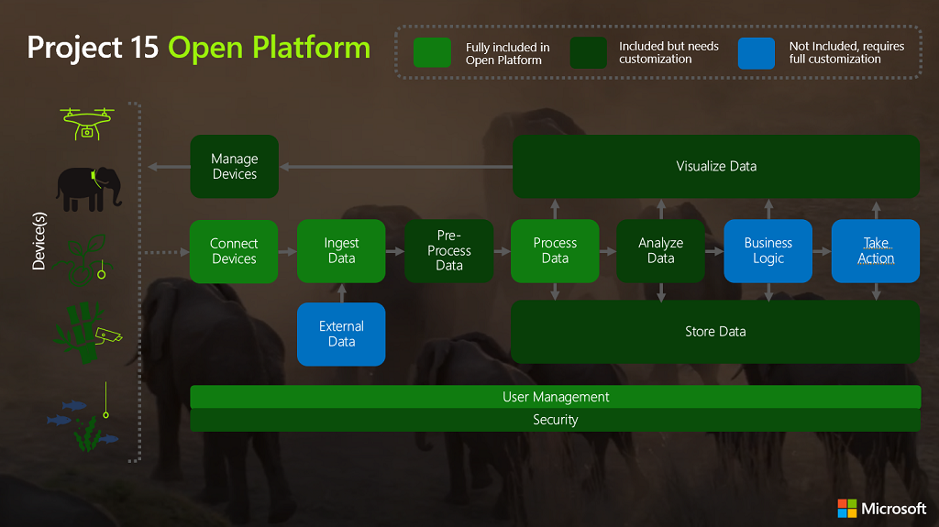
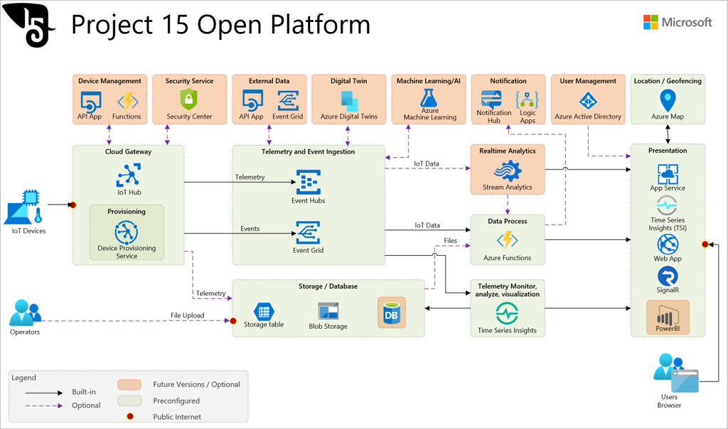
Architecture
Notes:
Jay

Slide 14








Project 15 Architecture
Azure IoT Device Provisioning Service
Azure Container Instance
Azure Storage Queue
IoT device with microphone
Azure Container Instance
Azure IoT Hub
Name of sound file to inference
CNN for Elephant detection
Inferences
Audio file acquisition
Audio file processing
Audio file ingestion
Sound segment file (60 sec)
Azure Blob storage
Raw files (24hr)
Azure Blob storage
Notes:
Vish

Slide 15
Building ML Models
Aim Using the processed spectrogram data as an input to a CNN to automatically categorise how many elephants are present
Why are we doing this?
To enable automation the workflow end to end
To improve accuracy by reducing human error
To save time, enabling researchers to focus their attention on complex problems
Our Approach Transfer learning looks to take advantage of models which have been pre-trained on large datasets, then fine tuning to our specific problem. This approach is becoming very popular for several reasons (quicker time to train, better performance, not needing lots of data) and we found it to work well.
Notes:
Henrietta

Slide 16
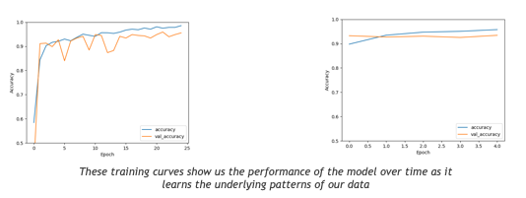
Model Summary
Implemented using keras with a tensorflow backend.
To evaluate the performance of our models we looked at the following measures of our two most promising architectures:
Resnet50
accuracy: 0.9620
loss: 0.1622
VGGNet
accuracy: 0.9477
loss: 0.3252
Notes:
Henrietta

Slide 17
Model - Resnet50
Below configuration was found to be optimal while running the classification task on Resnet50
Epochs: 25
Batch Size: 100
Weights = "imagenet"
Intermediate dense layers:
Nodes: 4 layers of 256,128,64 respectively
activation = 'relu'
Dropout = 0.5
BatchNormalization()
Final dense layer:
Nodes: 3
activation = 'softmax'
Optimizer: Adam with a learning rate of 0.001

Slide 18
Further Research
Machine learning on spectrograms using labelled data
Automatic classification and better acoustic analysis (https://journals.plos.org/plosone/article?id=10.1371/journal.pone.0048907)
Further fine-tuning of the boxing algorithm might lead to even better results, e.g.
Fixing the time axis in the spectrograms
Increasing the frequency range
Other (better) noise reduction techniques
Notes:
Chandan

Slide 19
Conclusions
Elephant counting based on base frequency analysis is possible
The team delivered a ready-to-use software library for counting elephants that with a high accuracy (97% on selected cases)
The software can be used in the IoT Hub (Project 15) or on-premise
The application can be integrated into other software
A machine learning model (VGG or Resnet50) could be used to count the elephants instead of the rule-based boxing algorithm
Further research is needed to improve the results, for example for broadening to other species

Slide 20
Thanks
Many thanks to all people who helped with the project, by providing insights, performing reviews, and participating in meetings:
Peter Wrege (Cornell University)
Liz Rowland (Cornell University)
Lee Stott (Microsoft)
Sarah Maston (Microsoft)
Thanks to the organizers of the "Artificial Intelligence – Cloud and Edge Implementations" course:
Ajit Jaokar (University of Oxford)
Peter Holland (University of Oxford)

